Slide 1
PROVE Tool Version Block2
Avi Shaked

Slide 2
PROVE Tool
The first tool to support rigorous development process design based on a research conducted at Tel Aviv University:
Hierarchical process composition
Artifact-based coordination
Composite states reflecting complex systems

Slide 3
PROVE Tool v2.0
One model to rule them all:
PROVE, DSM, state-charts (petri nets)
Meta-model redesigned
Rigorous model-based engineering
New representations
N²/DSM-like Interface Map
Artifact lifecycle diagram
Miscellaneous usability enhancements
Encapsulation mechanism for black-box / white-box view
Design related tips
Easier project setup (seed selection, auto diagram creation, default layers applied)
Graphical reconnect, improved deletion and artifact-in-state renaming

Slide 4
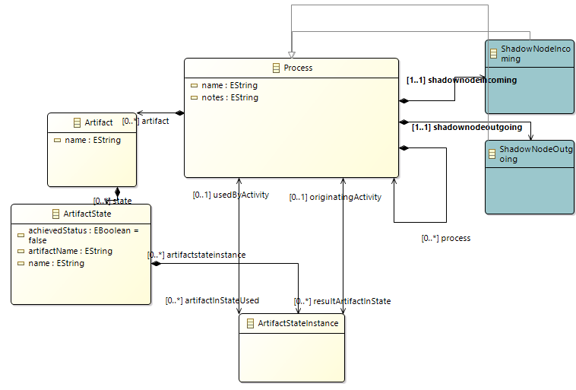
Meta-model (redesigned for V2.0)

Slide 5
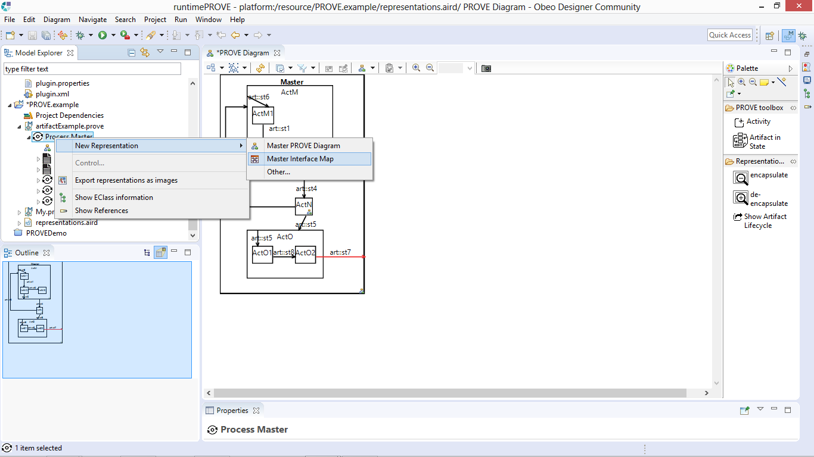
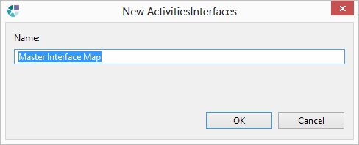
New representation: Interface Map
Right click on any desired process entity, and select the Interface Map new representation
Name the new representation and press “OK”

Slide 6
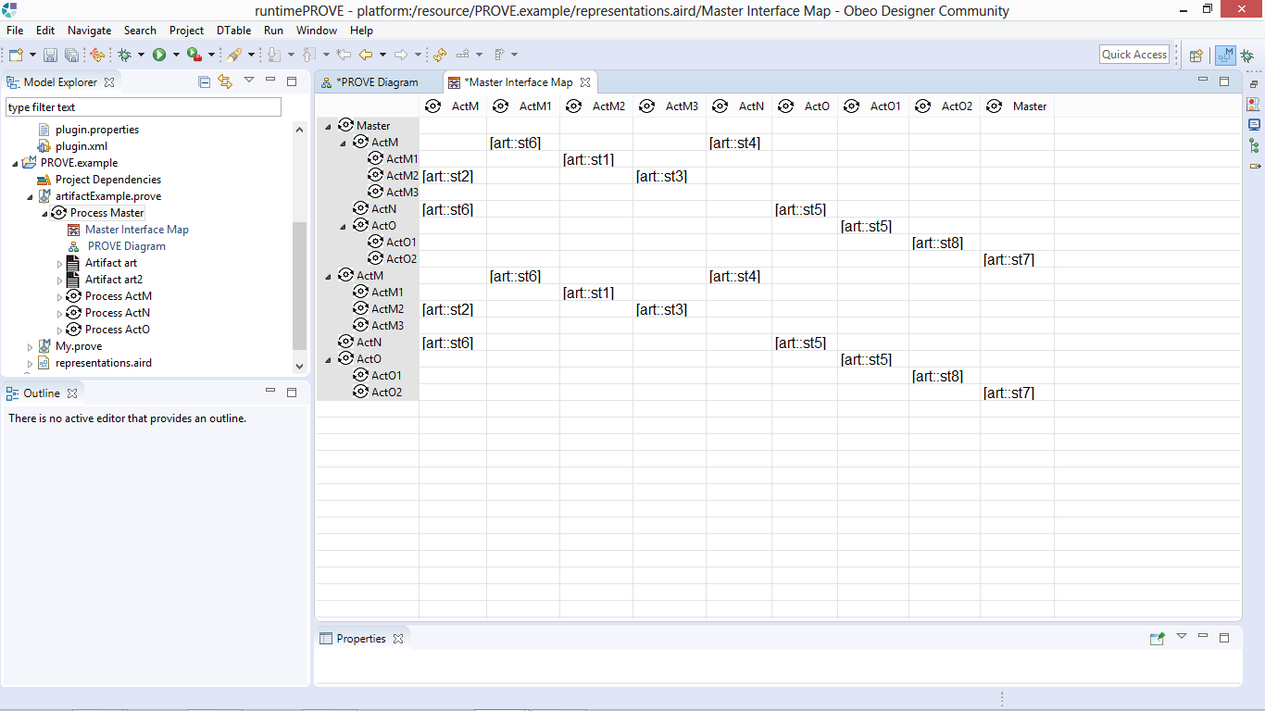
New representation: Interface Map
A new interface map is created*
* The map expresses hierarchical process composition only in its rows. This is due to limitations of PROVE Tool’s underlying infrastructure (EMF’s Sirius).

Slide 7
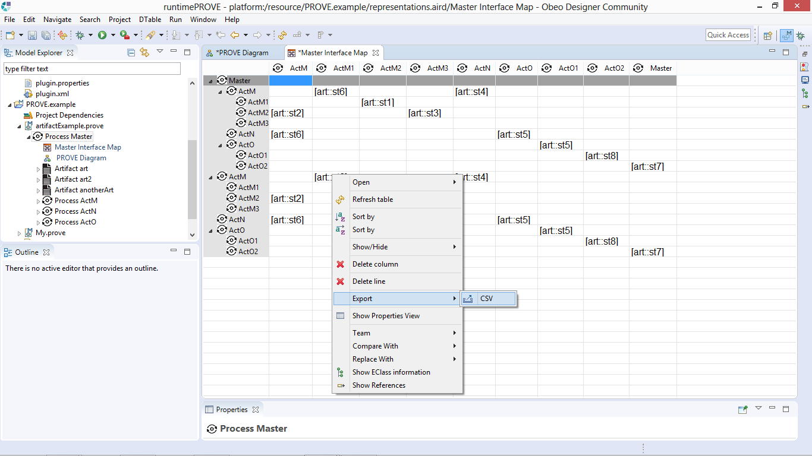
New representation: Interface Map
You may export the interface map as a CSV file (for further analysis as a DSM, for example)

Slide 8
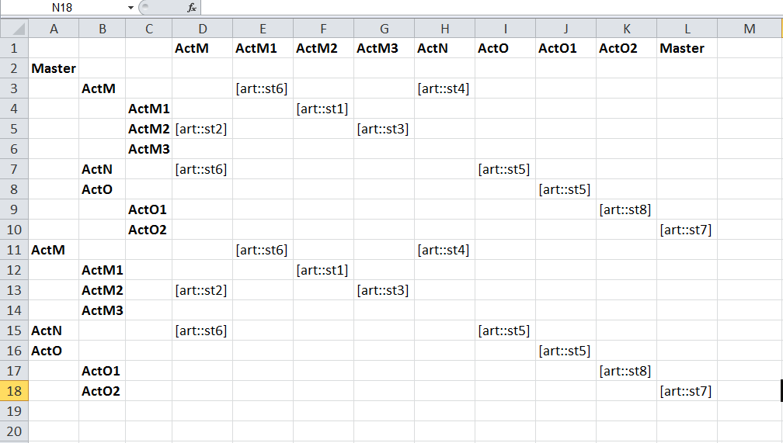
New representation: Interface Map
After a simple CSV import into Excel worksheet

Slide 9
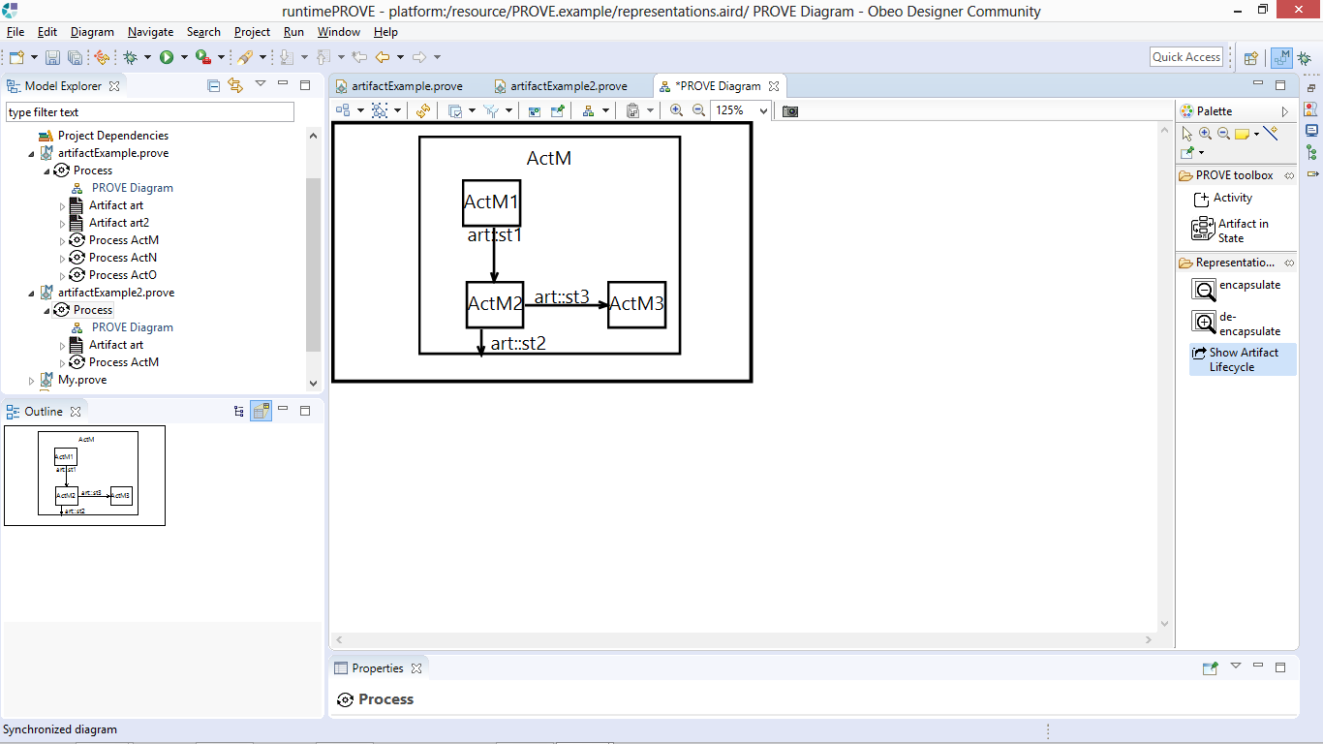
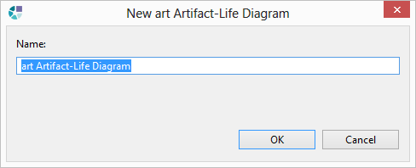
New representation: Artifact lifecycle
1. Select this tool and apply it to any artifact related diagram element (arrows)
2. Name the diagram and press OK (or accept the auto-generated default)

Slide 10
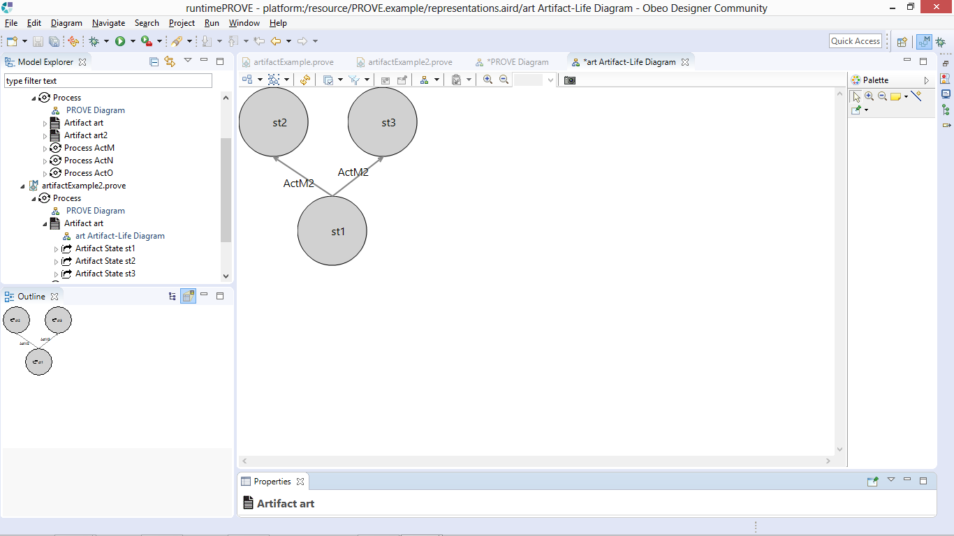
New representation: Artifact lifecycle
A synchronized artifact lifecycle diagram is presented

Slide 11
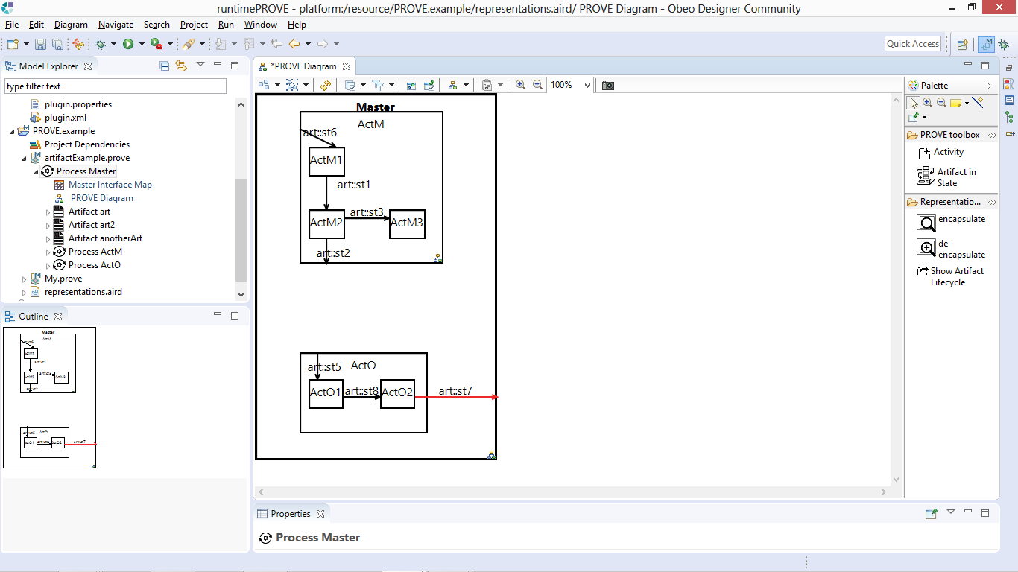
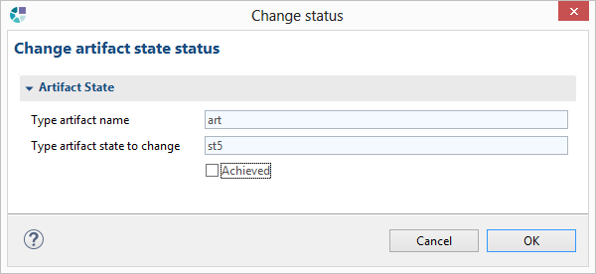
New representation: Artifact lifecycle
Let’s examine how artifact status is reflected in the created diagram
Double click on an artifact-in-state arrow
Set “Achieved” status and press “OK”
Repeat for another artifact-in-state

Slide 12
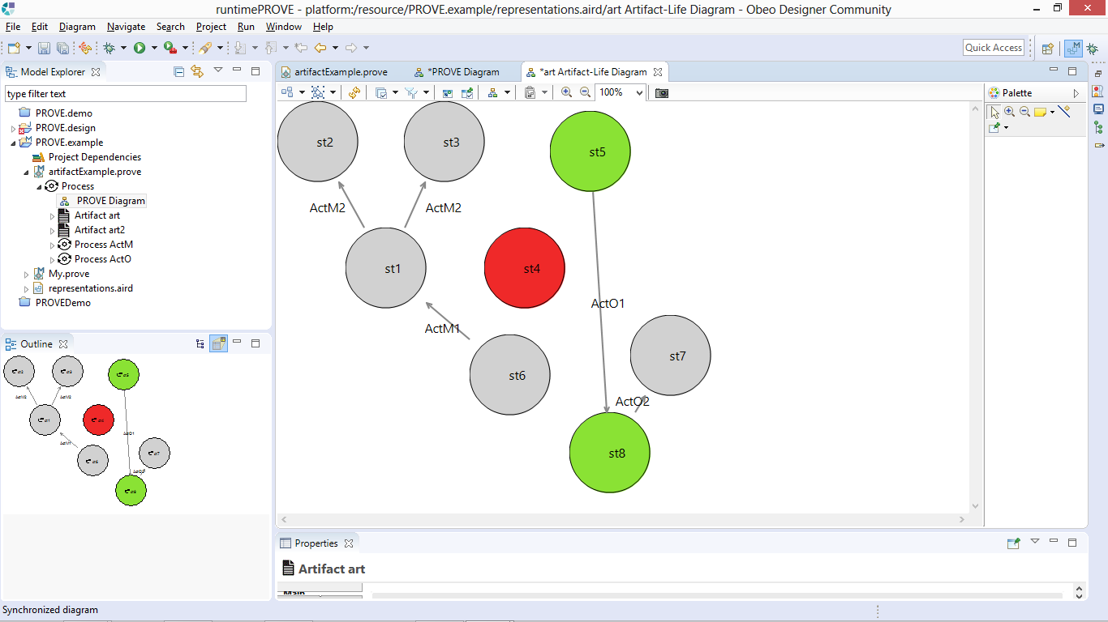
New representation: Artifact lifecycle
Achieved states are denoted in green
Unimplemented states are denoted in red

Slide 13
The artifact lifecycle diagram
Fully synchronized with the PROVE process design
Reveals the on-the-fly generated artifact elemental states and possible advancement throughout development
A unique hierarchy-aware context for state transitions
State transitions are presented based on their movement in a hierarchy level and between hierarchies
Indicates activities responsible for advancement from one state to another
a reciprocal view of the PROVE process design diagram
Indicates:
progress (nodes in green)
unused states (nodes in red)

Slide 14
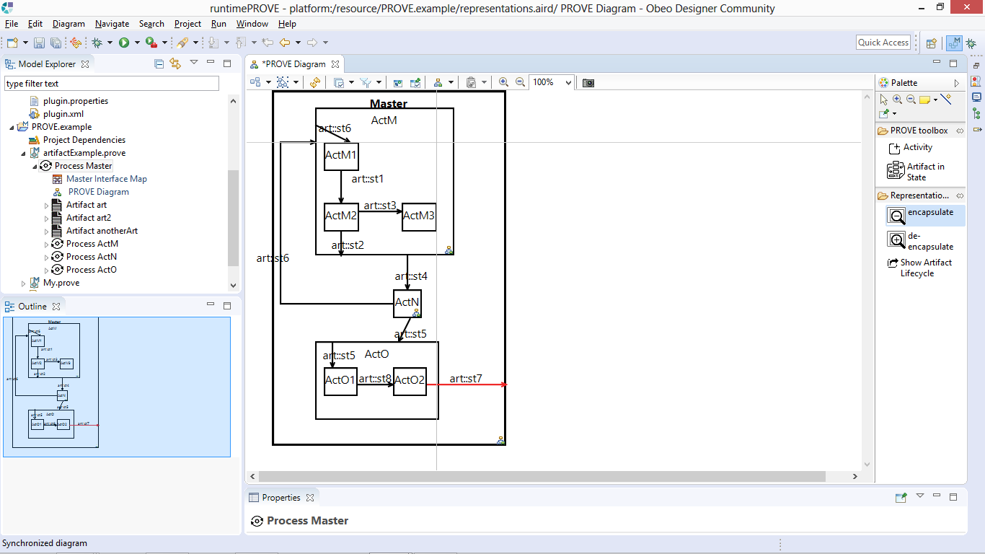
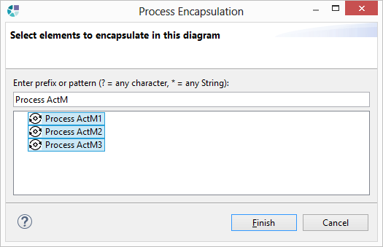
New representational feature: Process Encapsulation
1. Select this tool and apply it to any process hierarchy (box)
2. Select elements (preferably all by Ctrl+A) and click “Finish”

Slide 15
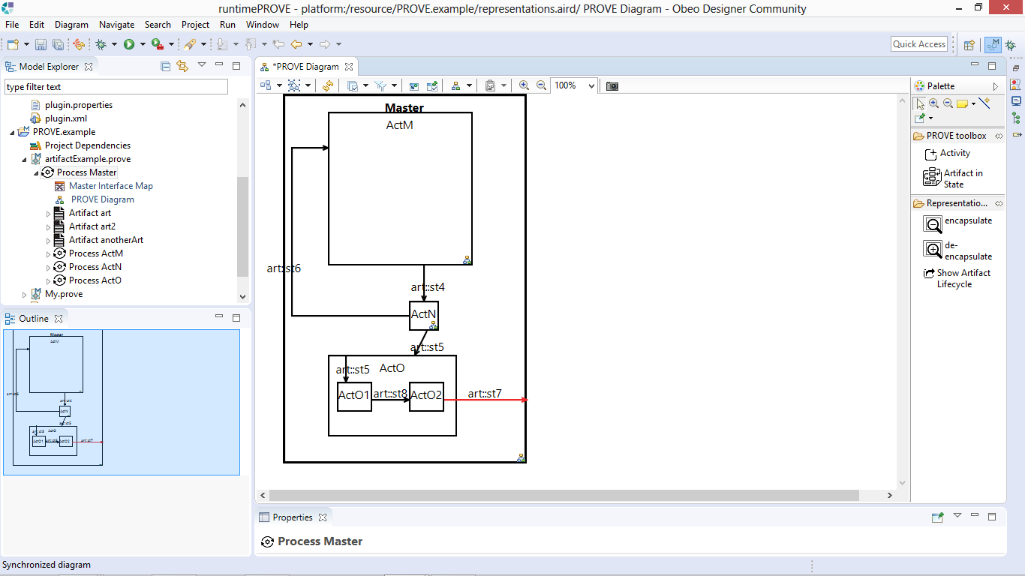
New representational feature: Process Encapsulation
The selected process now appears as a black-box in this specific diagram
Use this tool similarly, for the reverse action (white-box representation)

Slide 16
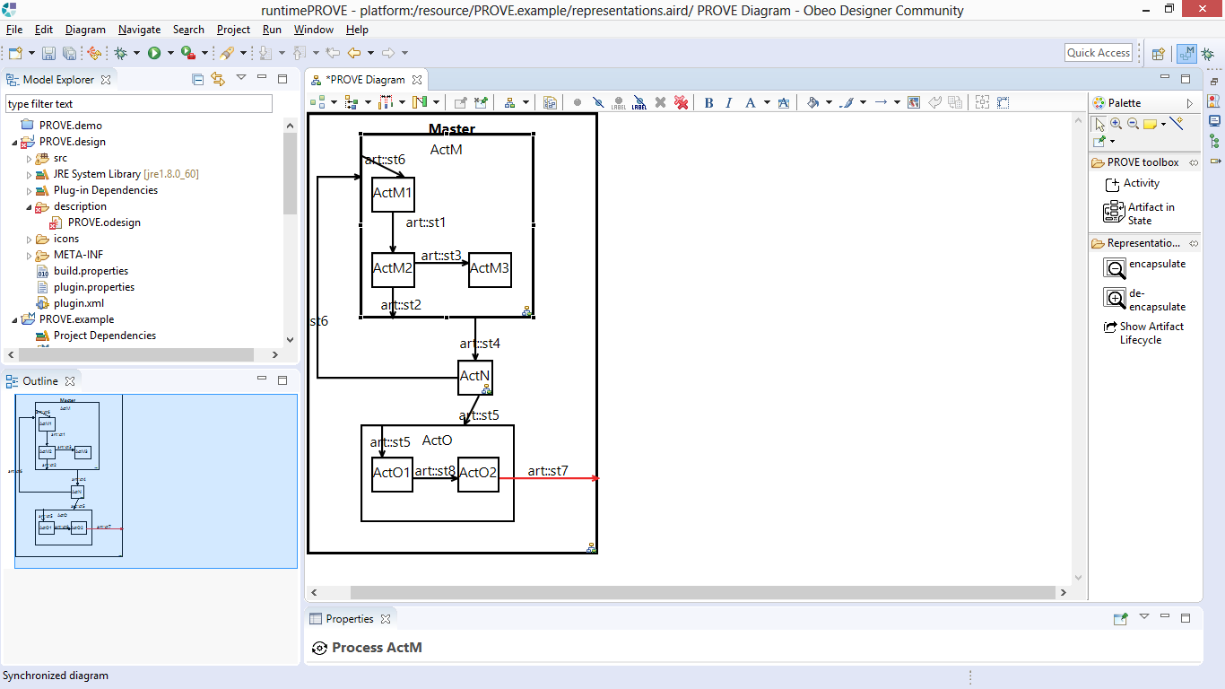
Design tips*
Artifact-in-states between different hierarchies are denoted in red
* Design tips appear when using “Process Design Analysis” layer (activated by default for PROVE diagrams)

Slide 17
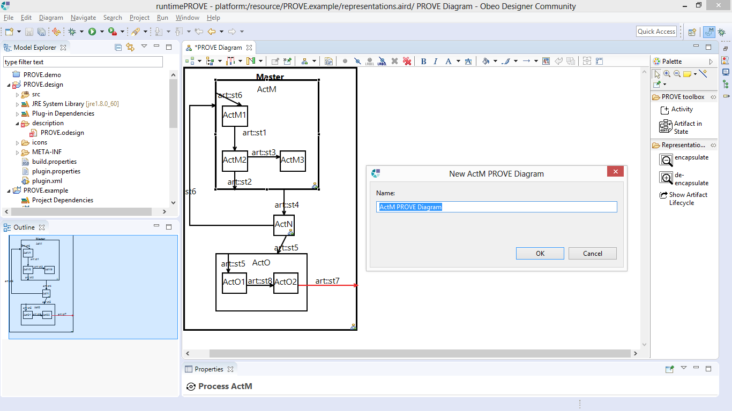
Design tips
Double click on a sub-process to navigate to its dedicated diagram (or create one)

Slide 18
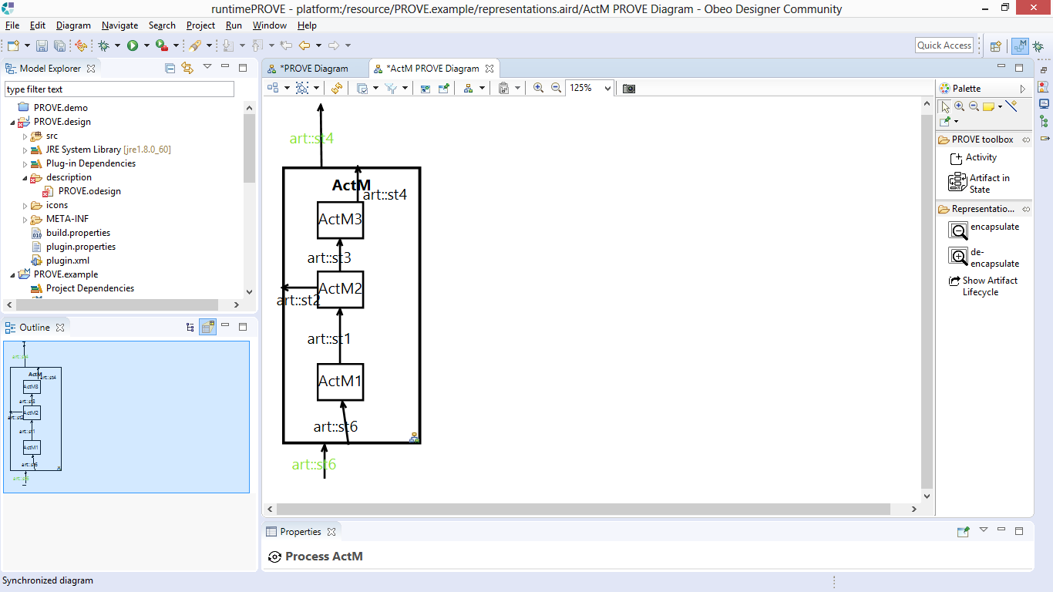
Design tips
Output artifact-in-state color changed to green, indicating it was created in the lower level hierarchy

Slide 19
Design tips
Examine ActO’s design

Slide 20
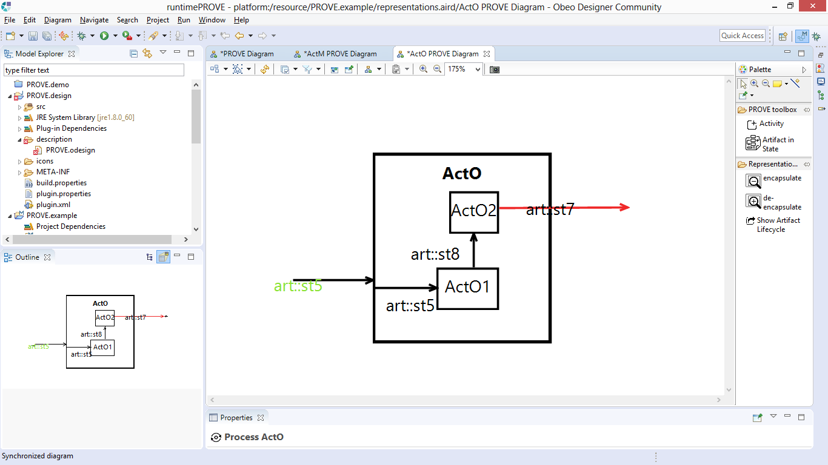
Design tips
Art::st7 is indicated as a between-hierarchies flow
Let’s correct this by moving the source to ActO

Slide 21
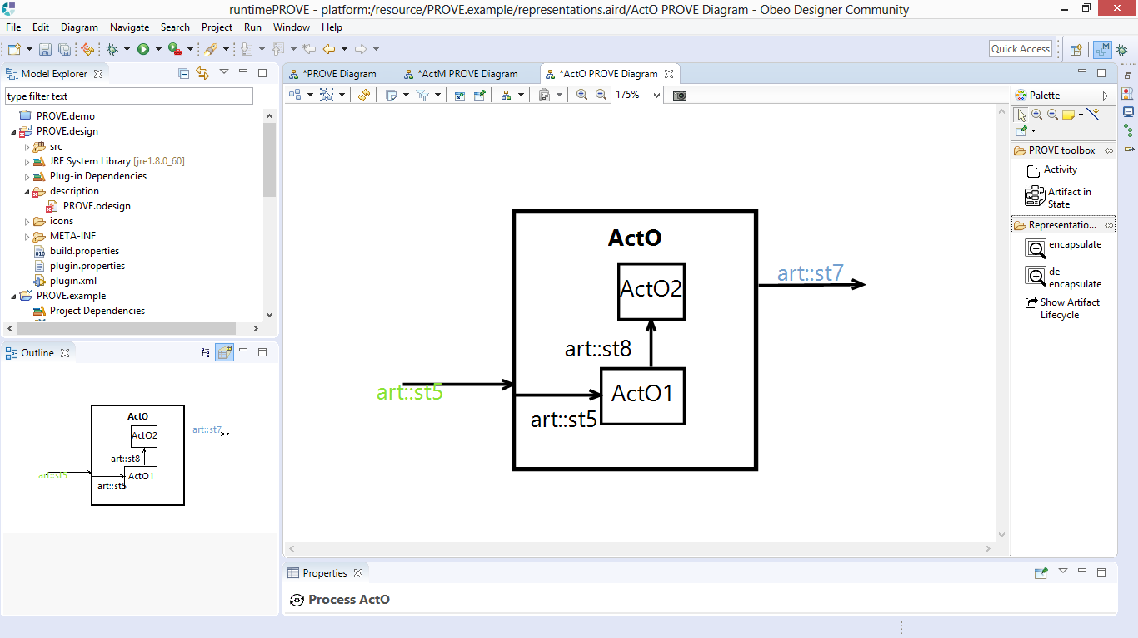
Design tips
Art::st7 is now indicated in blue
Let’s add a lower level implementation: ActO2 yield art::st7

Slide 22
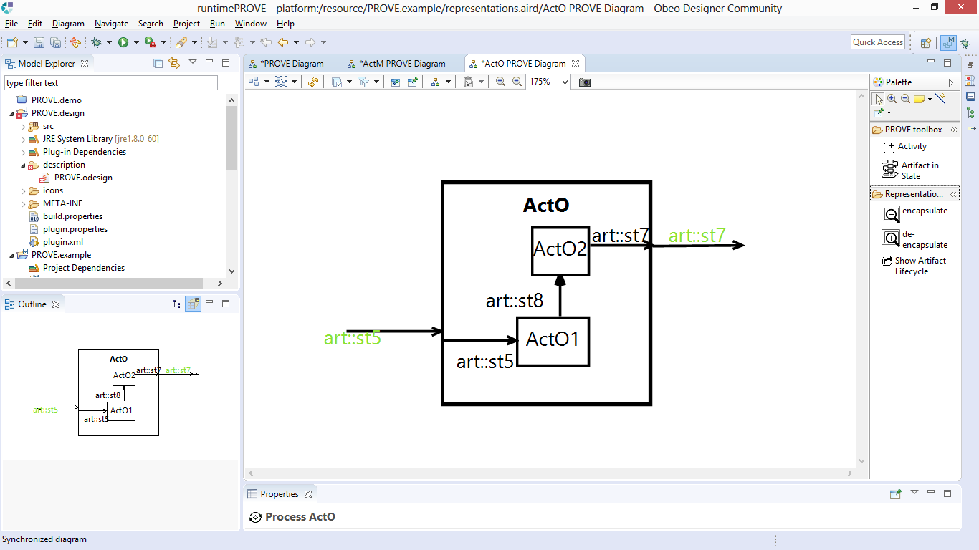
Design tips
Art::st7 is now indicated in green
Let’s examine how these changes are reflected in the higher-hierarchy (master process)

Slide 23
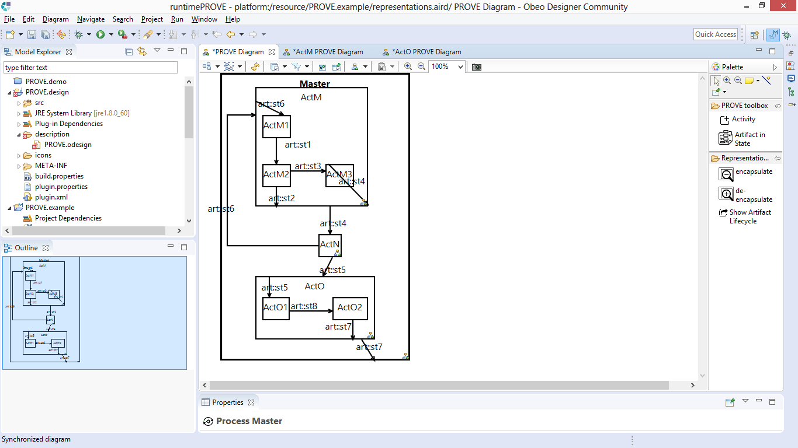
Design tips
The higher-level hierarchy diagram was automatically updated, and no longer indicates art:st7 in red

Slide 24
Thank you

